Slide 1

软工设计汇报-2
重新定义需求
汇报组：Old Driver
日期：2019.10.25

Slide 2
市场概况
01
目 录
问题陈述
02
CONTENT
系统划分
03
点击输入标题名称
04

Slide 3
01
市场概况

Slide 4
用户分析
家长需求 | 学生需求
超九成家长更愿选择中小规模的培训班，其中6-15人中班规模最受欢迎； | 对英语和数学的培训需求量大
频率以一周1~2次，一次2小时为佳 | 需要额外的监督来保证学习的质量
看重教师的教学水平，分数不再是王道。 | 需要符合自身特点的教育方式。如启发式教育、兴趣引导式教育、理论实践结合式教育。
数据来自：艾瑞咨询、极光大数据等。

Slide 5








竞品分析

Slide 6
竞品分析
品牌 | 特点
Vipkid | 只针对幼儿英语外教业务，企业自研课程，一对一。B2C。
学而思培优 | 针对全方位课程，大班直播课为主。B2C业务。
学大教育 | 针对全方位课程，大班直播课为主，B2C业务和O2O混合业务。
跟谁学 | 针对全方位课程，大班直播为主。O2O转型成B2C。
新东方在线 | 针对英语培训课程。全自营模式，B2C。

Slide 7
竞品分析
01
以B2C为主
02
自研课程
03
教师管理机制
04
丰富的多媒体教学

Slide 8
业务分析
01
02
03
04
家长购买
学生上课
课后练习
答疑反馈
01
02
03
04
*设计课程
教授学生
答疑反馈
教师考核和数据分析

Slide 9
业务流程
The user can demonstrate on a projector or computer, or presentation and make it film to be used in a wider field
标题文本预设
标题文本预设
The user can demonstrate on a projector or computer, or print the presentation and make it intoThe user candemonstrateThe user can demonstrate on a projector or computer, or print the presentation and make it intoThe user
The user can demonstrate on a projector or computer, or print the presentation and make it intoThe user candemonstrateThe user can demonstrate on a projector or computer, or print the presentation and make it intoThe user
家长购买
学生上课
课后练习
答疑反馈
关键词
关键词

Slide 10

业务分析
业务模式
B2C为主，O2O为辅助。课程的体现形式多样化。
标题文字添加
The user can demonstrate on a projector or computer, or print the presentation and make it intoThe user can demonstrate
标题文字添加
The user can demonstrate on a projector or computer, or print the presentation and make it intoThe user can demonstrate

Slide 11
02
需求更新

Slide 12
问题陈述
微信端（服务号加小程序）：
家长接受学生的上课信息，以及学生的课堂课后表现等。
学生拍照上传作业信息，进行提问并接受答疑的反馈。
平台方推广学生感兴趣的相关课程。
教室通过微信服务号进行及时答疑。
web端：
教师角色可以添加课程，修改、删除自己上传的课程还可以进行课程直播教学、发放和批改课程作业。
学生进行选课，上课，完成作业。
家长浏览网上课程信息，与学生账号进行绑定。
web端：
平台方进行教师的上课监管，KPI考核等。对课程进行数据分析，上传课程。对账户进行管理等。
课程运营方根据数据反馈对课程进行推广

Slide 13
03
子系统划分

Slide 14
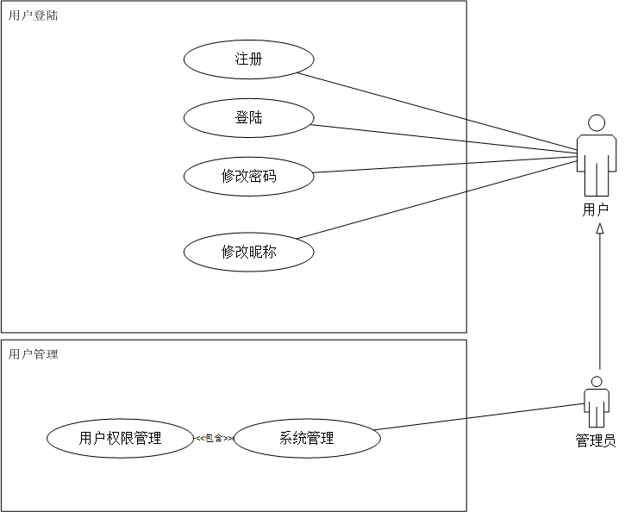
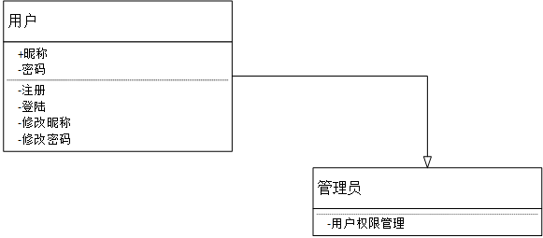
用户登录模块
用户登录模块
（1）注册账号：用户名、密码、角色。
教师注册时需额外提供教师资格证明。
（2）登陆：验证用户名和密码是否存在且匹配。

Slide 15
课程设置模块
课程设置模块
（1）学生家长：
①浏览课程：查看课程基本信息，如年级、名称、大纲、授课教师、上课时间、价格和评价；
②购买课程：选择购买方式，包括单独购买和套餐式购买。
（2）教师：
①上传课程：教师发布课程基本信息；
②修改课程：教师对发布的课程信息进行修改；
③删除课程：教师删除本人上传的课程信息。

Slide 16
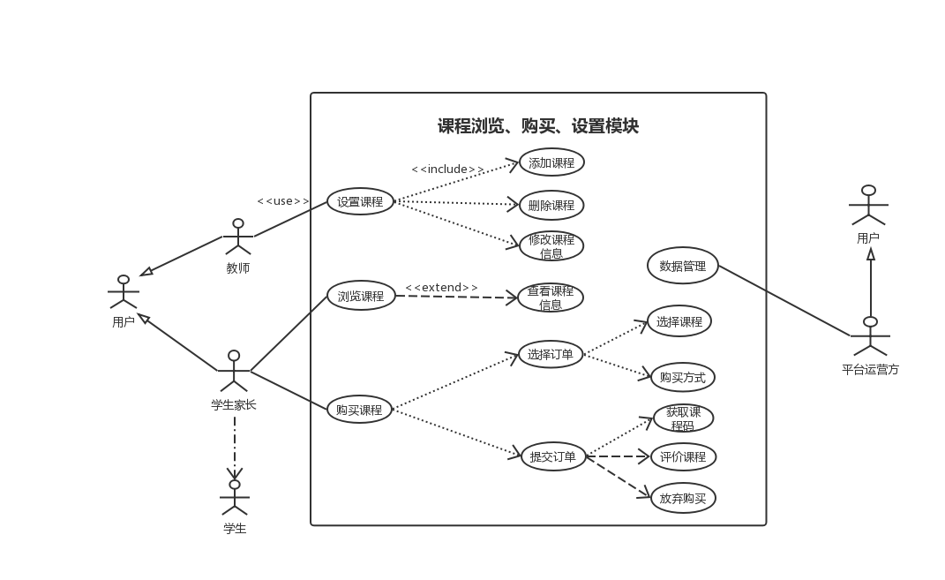
课程设置模块

Slide 17
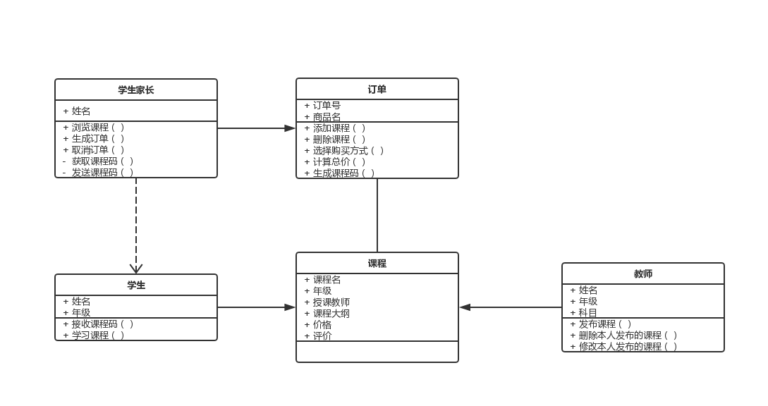
课程设置模块

Slide 18
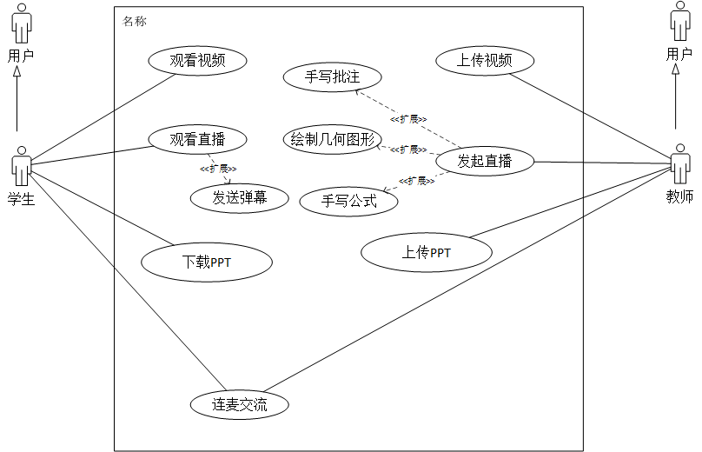
课程教学模块
课程教学模块
（1）学生：通过课程码进入课程，观看课程直播和视频回放。
（2）教师：上传课件、直播教学。

Slide 19
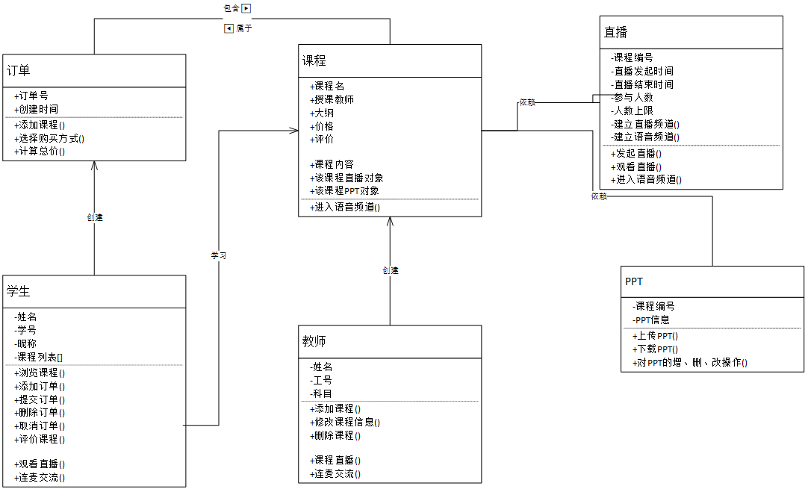
课程教学模块

Slide 20
作业模块
作业模块
（1）课程作业：由教师发布，学生在截止日期前完成，在教师批改后可以查看并订正，错题可以加入错题本。
（2）系统题库：由系统提供题目和批改，学生可以自主选择进行练习。

Slide 21
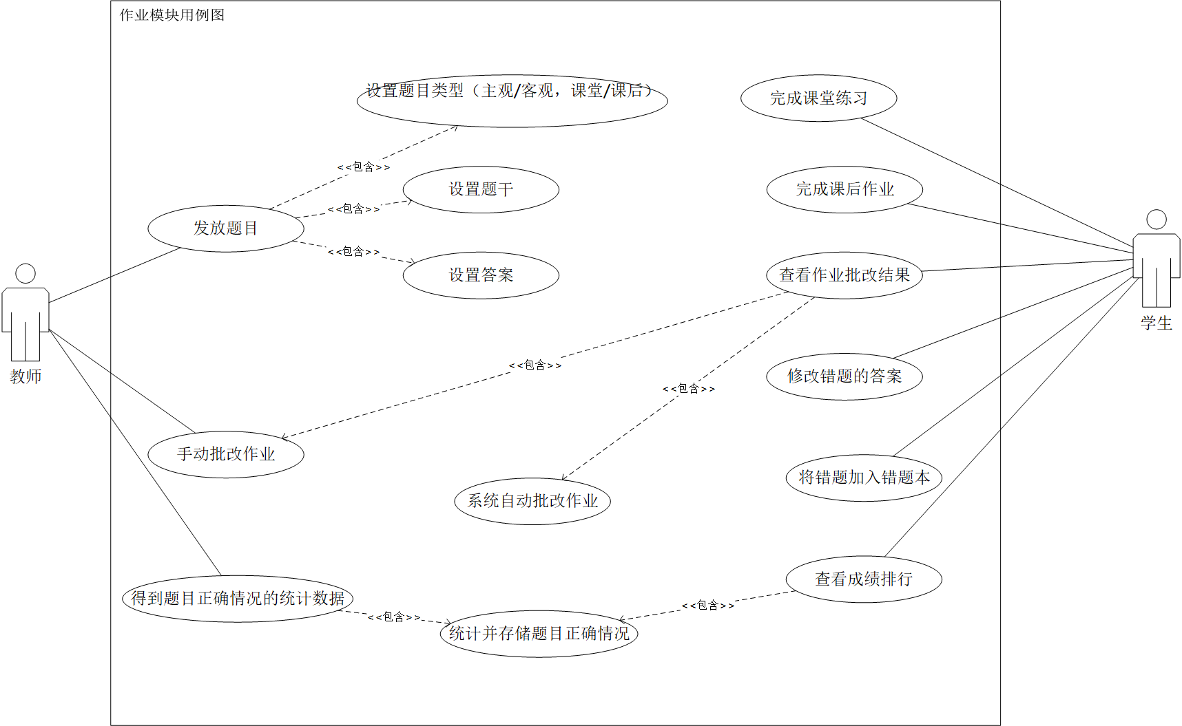
作业模块

Slide 22
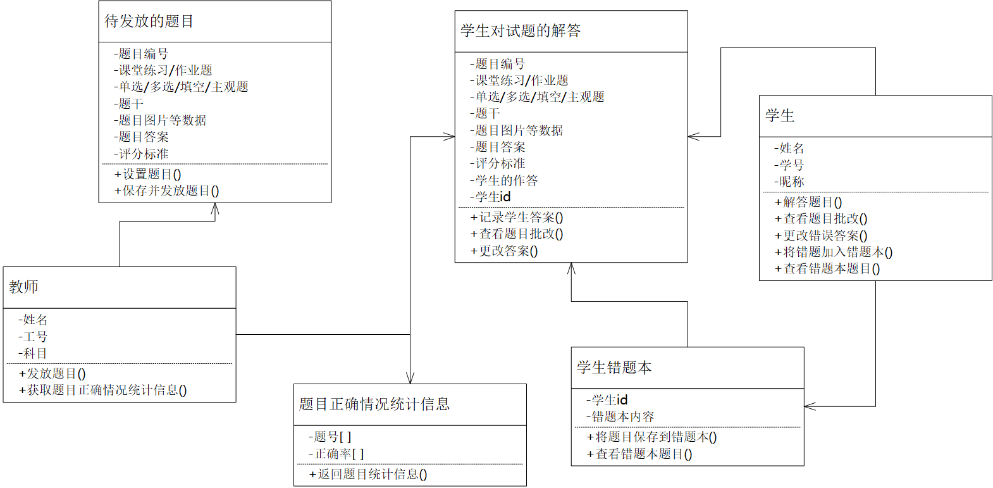
作业模块

Slide 23
监控模块
（1）监控教师、课程质量（包括课程直播守时程度、课程评价、课程购买量等）。
（2）监控平台运行情况。
（3）统计、分析学生的学习情况（直播观看次数、作业完成情况、测试成绩等）。
(4) 对教师进行监管，监控教师教学时学生的反馈频率，答疑的时间等。

Slide 24
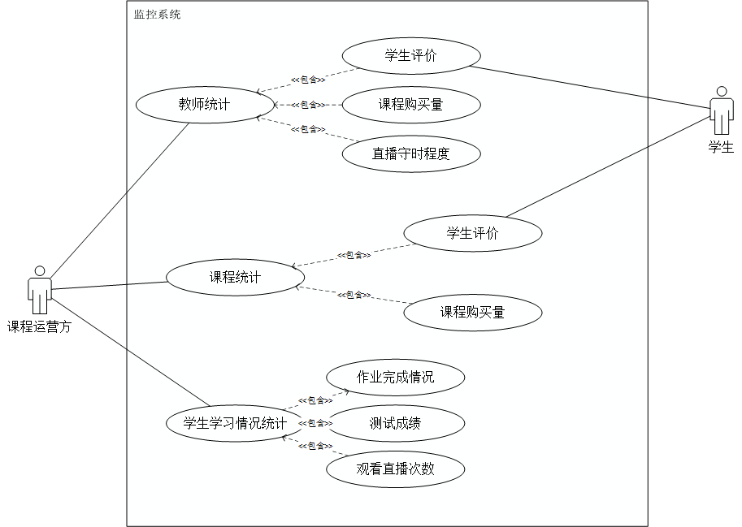
监控模块

Slide 25
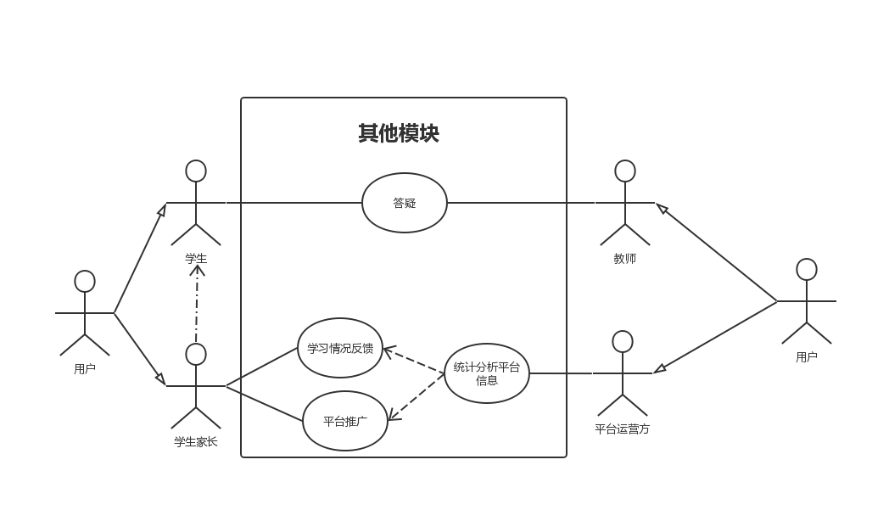
其他模块
（1）答疑：包括一对一和一对多答疑。
（2）反馈：家长在微信服务号输入课程码，后台将自动发送学生该课程的学习情况（直播观看情况、作业完成情况、测试成绩等）。
（3）推广：不定期发布推广文章，推送内容包括但不限于课程推广。

Slide 26
标题文字添加名称
The user can demonstrate on a projector or computer, or presentation and make it film to be used in a wider field
This template is exclusively designed by Fei er creative, and copyrights belong to Bao tu internet
This template is exclusively designed by Fei er creative, and copyrights belong to Bao tu internet
2021
2021
2021
2021
2021
2021
This template is exclusively designed by Fei er creative, and copyrights belong to Bao tu internet
This template is exclusively designed by Fei er creative, and copyrights belong to Bao tu internet
This template is exclusively designed by Fei er creative, and copyrights belong to Bao tu internet
This template is exclusively designed by Fei er creative, and copyrights belong to Bao tu internet

Slide 27

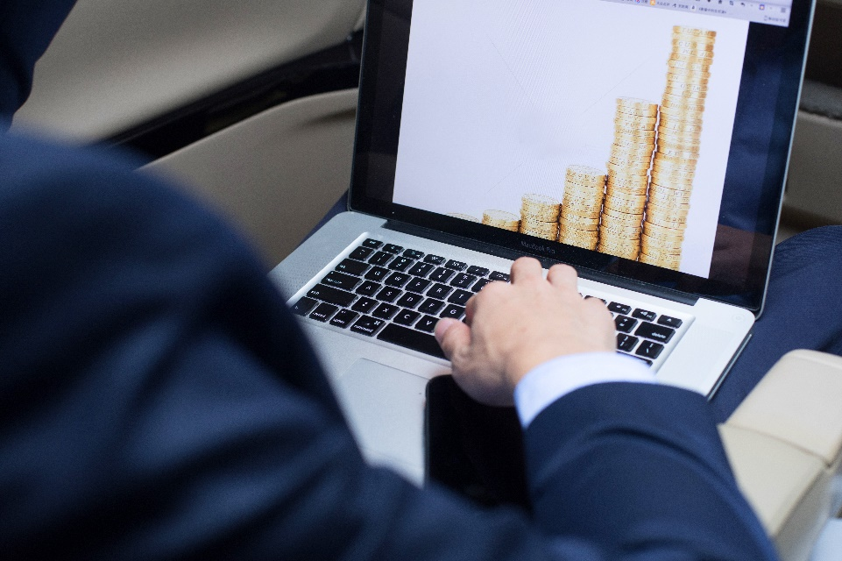

标题文字添加名称
The user can demonstrate on a projector or computer, or presentation and make it film to be used in a wider field
This template is exclusively designed by Fei er creative, and copyrights belong to Bao tu internet.
82%
标题添加
标题添加
标题添加
标题添加
标题添加
标题添加

Slide 28
标题文字添加名称
The user can demonstrate on a projector or computer, or presentation and make it film to be used in a wider field
2021年
This template is exclusively designed by Fei er creative, and copyrights belong to Bao tu internet
2021年
This template is exclusively designed by Fei er creative, and copyrights belong to Bao tu internet
2021年
This template is exclusively designed by Fei er creative, and copyrights belong to Bao tu internet
2021年
This template is exclusively designed by Fei er creative, and copyrights belong to Bao tu internet

Slide 29
标题文字添加名称
The user can demonstrate on a projector or computer, or presentation and make it film to be used in a wider field
This template is exclusively designed by Fei er creative and copyrights belong to Bao tu internetThis template is exclusively designed by Fei erThis template is exclusively designed by Fei er creative and copyrights belong to Bao tu internetThis template is exclusively
添加标题
添加标题
This template is exclusively designed by Fei er creative and copyrights belong to Bao tu
This template is exclusively designed by Fei er creative and copyrights belong to Bao tu
添加标题
添加标题
This template is exclusively designed by Fei er creative and copyrights belong to Bao tu
This template is exclusively designed by Fei er creative and copyrights belong to Bao tu

Slide 30
标题文字添加名称
The user can demonstrate on a projector or computer, or presentation and make it film to be used in a wider field
2021年
包图网提供全面且质优的多品类设计素材打破传统素材网站单向沟通的服务模式
2021年
包图网提供全面且质优的多品类设计素材打破传统素材网站单向沟通的服务模式
2021年
包图网提供全面且质优的多品类设计素材打破传统素材网站单向沟通的服务模式
2021年
包图网提供全面且质优的多品类设计素材打破传统素材网站单向沟通的服务模式
2021年
包图网提供全面且质优的多品类设计素材打破传统素材网站单向沟通的服务模式

Slide 31


标题文字添加名称
The user can demonstrate on a projector or computer, or presentation and make it film to be used in a wider field
我们的团队
输入标题名称
This template is exclusively designed by Fei er creative and copyrights belong to Bao tu internetThis template is exclusively designed by Fei er creative and copyrights belong to Bao tu internet
This template is exclusively designed by Fei er creative and copyrights belong to Bao tu internetThis template is exclusively designed by Fei er creative and copyrights belong to Bao tu internet
This template is exclusively designed by Fei er creative and copyrights belong to Bao tu internetThis template is exclusively designed by Fei er creative and copyrights belong to Bao tu internet
输入标题名称
This template is exclusively designed by Fei er creative and copyrights belong to Bao tu internetThis template is exclusively designed by Fei er creative and copyrights belong to Bao tu internet
This template is exclusively designed by Fei er creative and copyrights belong to Bao tu internetThis template is exclusively designed by Fei er creative and copyrights belong to Bao tu internet

Slide 32
标题文字添加名称
The user can demonstrate on a projector or computer, or presentation and make it film to be used in a wider field
2021年
2021年
2021年
2021年
01
02
03
04
标题添加
标题添加
标题添加
标题添加
This template is exclusively designed by Fei er creative, and copyrights belong
This template is exclusively designed by Fei er creative, and copyrights belong
This template is exclusively designed by Fei er creative, and copyrights belong
This template is exclusively designed by Fei er creative, and copyrights belong

Slide 33
标题文字添加名称
The user can demonstrate on a projector or computer, or presentation and make it film to be used in a wider field
2021年
2021年
This template is exclusively designed by Fei er creative, and copyrights belong to Bao tu internet
This template is exclusively designed by Fei er creative, and copyrights belong to Bao tu internet
2021年
2021年
This template is exclusively designed by Fei er creative, and copyrights belong to Bao tu internet
This template is exclusively designed by Fei er creative, and copyrights belong to Bao tu internet

Slide 34





标题文字添加名称
The user can demonstrate on a projector or computer, or presentation and make it film to be used in a wider field
输入标题名称
输入标题名称
This template is exclusively designed by Fei er creative and copyrights belong to Bao tu internetThis template is exclusively
This template is exclusively designed by Fei er creative and copyrights belong to Bao tu internetThis template is exclusively
输入标题名称
输入标题名称
输入标题名称
This template is exclusively designed by Fei er creative and copyrights belong to Bao tu internetThis template is exclusively
This template is exclusively designed by Fei er creative and copyrights belong to Bao tu internetThis template is exclusively
This template is exclusively designed by Fei er creative and copyrights belong to Bao tu internetThis template is exclusively

Slide 35
标题文字添加名称
The user can demonstrate on a projector or computer, or presentation and make it film to be used in a wider field
2021
2021
2021
标题添加
标题添加
标题添加
This template is exclusively designed by Fei er creative, and copyrights belong to Bao tu internet
This template is exclusively designed by Fei er creative, and copyrights belong to Bao tu internet
This template is exclusively designed by Fei er creative, and copyrights belong to Bao tu internet

Slide 36
标题文字添加名称
The user can demonstrate on a projector or computer, or presentation and make it film to be used in a wider field
2021
标题添加
This template is exclusively designed by Fei er creative, and copyrights belong to Bao tu internet
标题添加
2020
This template is exclusively designed by Fei er creative, and copyrights belong to Bao tu internet
2019
标题添加
This template is exclusively designed by Fei er creative, and copyrights belong to Bao tu internet
标题添加
2018
This template is exclusively designed by Fei er creative, and copyrights belong to Bao tu internet

Slide 37
标题文字添加名称
The user can demonstrate on a projector or computer, or presentation and make it film to be used in a wider field
标题文字添加
标题文字添加
The user can demonstrate on a projector or computer, or print the presentation and make it intoThe user candemonstrate
The user can demonstrate on a projector or computer, or print the presentation and make it intoThe user candemonstrate
45%
18%
40%
12%
标题文字添加
标题文字添加
The user can demonstrate on a projector or computer, or print the presentation and make it intoThe user candemonstrate
The user can demonstrate on a projector or computer, or print the presentation and make it intoThe user candemonstrate

Slide 38

标题文字添加名称
The user can demonstrate on a projector or computer, or presentation and make it film to be used in a wider field
标题文字添加
The user can demonstrate on a projector or computer, or print the
标题文字添加
The user can demonstrate on a projector or computer, or print the
标题文字添加
The user can demonstrate on a projector or computer, or print the

Slide 39

标题文字添加名称
The user can demonstrate on a projector or computer, or presentation and make it film to be used in a wider field
标题文字添加
The user can demonstrate on a projector or computer, or print the
标题文字添加
标题文字添加
The user can demonstrate on a projector or computer, or print the
The user can demonstrate on a projector or computer, or print the
标题文字添加
The user can demonstrate on a projector or computer, or print the
标题文字添加
The user can demonstrate on a projector or computer, or print the

Slide 40
感谢聆听！
重新定义需求
汇报组：Old Driver
日期：2019.10.25

